Slide 1
Data Model
7

Slide 2
Today’s Agenda
Data Model
Types of Data Model

Slide 3
Data Models
Data models are collection of conceptual tools for describing data, data relationships, data semantics and data constraints.
Data Model gives us an idea that how the final system will look like after its complete implementation.
It defines the data elements and the relationships between the data elements.
Data Models are used to show how data is stored, connected, accessed and updated in the database management system

Slide 4
Why to use data models
The Primary goals of using data model are:
Ensures that all data objects required by the database are accurately represented.
A data model helps to design the database at the conceptual, physical and logical levels.
Data model structure helps to define the relation tables, primary and foreign keys and stored procedures.
It provides a clear picture of the base data and can be used by database developers to create a physical database.
It is also helpful to identify missing and redundant data.

Slide 5
Types of Data Models
There are many data models, chosen as per the need of the application. One data model can be distinguished from other on the basis of data representation and the way data is conceptually defined.
There are three different groups:
1. Object based logical models
2. Record-based logical models
3. Physical data models

Slide 6
Object based logical models
Describe data at conceptual and view levels.
Provide flexible structure capabilities.
Allow one to specify data constraints explicitly.
The model emphasize that everything is object having a set of attribute.
There are many data models in this category including:
Entity-Relationship model
Object-Oriented Model
Binary Model
Semantic Data Model
Infological Model
Functional Data Model

Slide 7
Record based logical models
It also describe data at the conceptual and view level.
Unlike object-oriented models, it is used to specify overall logical structure of the database and provide a higher-level description of the implementation.
Named so because the database is structured in fixed format records of several types.
Each record type defines a fixed number of fields or attributes.
Each field is usually of a fixed length.
Record-based models do not include a mechanism for direct representation of code in the database.
Separate language associated with the model are used to express database queries and updates.
The three most widely accepted record based models are:
Relational model
Network model
Hierarchical model

Slide 8
Physical data model
Describe data at the lowest level.
To describe the behavior of data at the disk level, the way the data and data relationship are maintained while storing them on the disk.
Decide the way the DBMS is going to use secondary storage device for storing and accessing database.
Very few models are in this category including:
Unifying model
Frame memory model

Slide 9
Entity-Relationship (E-R)model
The E-R data model is based on the perception of a real world that consists of basic objects, called entities and of relationship among these objects.
The E-R model is a high level conceptual data model developed by Chen in 1976 to facilitate database design. A conceptual data model is a set of concepts that describe the structure of a database and the associated retrieval and updation on the database.
The basic concept of the E-R model is based on entity type, relationship type and attribute.

Slide 10
Components of E-R model
Entities
Attributes
Relationship

Slide 11
Entities
A real-world thing either living or non-living that is easily recognizable and nonrecognizable. It is anything in the enterprise that is to be represented in our database. It may be a physical thing or simply a fact about the enterprise or an event that happens in the real world.
An entity can be place, person, object, event or a concept, which stores data in the database. The characteristics of entities are must have an attribute, and a unique key. Every entity is made up of some 'attributes' which represent that entity.
Examples of entities:
Person: Employee, Student, Patient
Place: Store, Building
Object: Machine, product, and Car
Event: Sale, Registration, Renewal
Concept: Account, Course

Slide 12
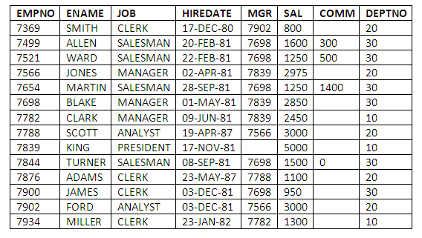
Example

Slide 13

Notation used in ER model Diagram
Entities are represented by rectangle either with round or square corners. For example if customer is an entity then it is represented as follows:

Slide 14
Continue
An entity is further classified into two types, i.e. tangible entity and intangible entity:
A tangible entity is one which physically exists in real-world. Such as a person, student, bank locker, etc. are examples of tangible entities, we can touch them as they physically exist.
An intangible entity is one which exists logically in real-world such as bank account, reservation, email account etc. Like a tangible entity, we can easily identify the intangible entity such as a bank account has an account no. using which we can easily identify that bank account, but we cannot touch it, as it doesn’t exist physically in the real world.

Slide 15
Attributes
Attributes describe the characteristics or properties of an entity in a database table. An entity in a database table is defined with the ‘fixed’ set of attributes. For example, if we have to define a student entity then we can define it with the set of attributes like roll number, name, course. The attribute values, of each student entity, will define its characteristics in the table.
In a relational database, we store data in the form of tables. The column header of the table represents the attributes. A table must not have duplicate attributes. Each attribute in a table has a certain domain which allows it to accept a certain ‘set of values’ only. In an entity, each attribute is allowed to have only one value which could be a number, text, date, time etc.

Slide 16
Attributes
Attributes describe the characteristics or properties of an entity in a database table. An entity in a database table is defined with the ‘fixed’ set of attributes. For example, if we have to define a student entity then we can define it with the set of attributes like roll number, name, course. The attribute values, of each student entity, will define its characteristics in the table.
In a relational database, we store data in the form of tables. The column header of the table represents the attributes. A table must not have duplicate attributes. Each attribute in a table has a certain domain which allows it to accept a certain ‘set of values’ only. In an entity, each attribute is allowed to have only one value which could be a number, text, date, time etc.

Slide 17
Key Differences Between Entity and Attribute
The basic difference between entity and attribute is that an entity is a distinguishable real-world object that exists, whereas attribute describes the elementary features of an entity.
In the relational database model entities are termed as record and attributes are termed as fields.
In the relational database model, we store data in the tables. So, the rows of table denote the entities and the column header of the table denotes attributes of an entities in a table.
An entity can either be a tangible entity or an intangible entity. On the other hand, the refinement of attributes includes the domain of attribute and key attributes.
The entities sharing the same elementary properties (attributes) are grouped in one entity set. The set of attributes that can distinguish an entity in a table is grouped to form a key.
The entire information of a single student in a student table represents an entity. The name, roll no, course parameters that form the complete information of a student are attributes of the student entity.

Slide 18
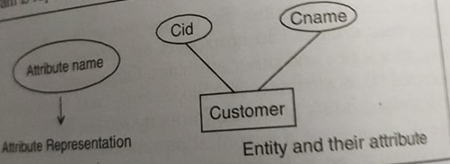
Attribute representation

Slide 19
Entity set
Entity Set
An entity set is a set of entities of the same type that share the same properties or attributes. The set of all person who are customers at a given bank can be defined as the entity set customer. Similarly the entity set loan might represent the set of all loans given by a particular bank.

Slide 20


